Slide 1

Selected Topics in Computational Intelligence I
Session 1
Introduction to Computational Intelligence

Slide 2
Agenda
AI and Soft computing
From Conventional AI to Computational Intelligence
Computational Intelligence Paradigms
Artificial Neural Networks
Evolutionary Computation
Swarm Intelligence
Fuzzy Systems

Slide 3
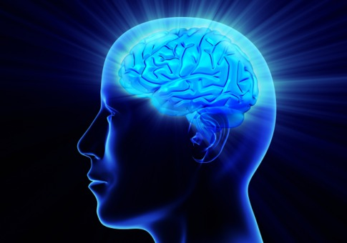
What is Intelligence
Dictionaries define intelligence as the ability to comprehend, to understand and profit from experience.
Other keywords that describe aspects of intelligence include creativity, skill, consciousness, emotion and intuition.
A more recent definition of artificial intelligence came from the IEEE Neural Networks Council of 1996:
The study of how to make computers do things at which people are doing better.

Slide 4
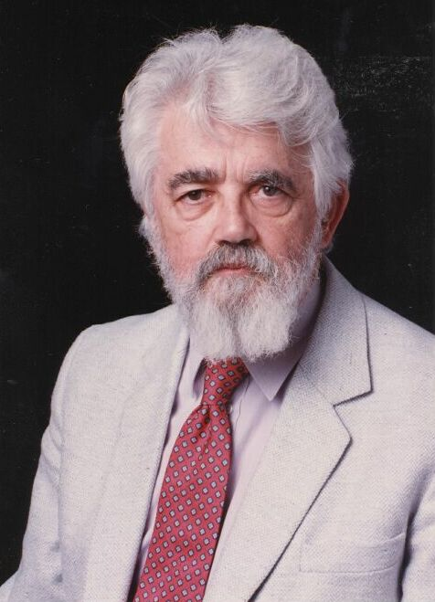
Artificial Intelligence
The term artificial intelligence was first coined in 1956 at the Dartmouth conference, organized by John McCarthy – now regarded as the father of AI.
From 1956 to 1969 much research was done in modeling biological neurons.
Most notable was the work on perceptrons by Rosenblatt, and the adaline by Widrow and Hoff.

Slide 5
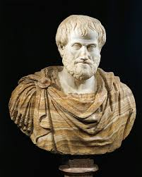
Relax
Aristotle (384–322 bc) was possibly the first to move toward the concept of artificial intelligence. His aim was to explain and codify styles of deductive reasoning, which he referred to as syllogisms.

Slide 6
Deductive Reasoning
Deductive Reasoning start from general observation, then generate specific conclusion from it.
Example:
Semua mahluk hidup akan mati.
Manusia adalah mahluk hidup.
Setiap Manusia pasti akan tiba waktunya untuk mengalami kematian (conclusion)

Slide 7
Soft Computing
Hard Computing (conventional) requires a precisely stated analytical model and often a lot of computation time. Many analytical models are valid for ideal cases. Real world problems exist in a non-ideal environment.
Soft computing was introduced by Prof. Lotfi Zadeh in 1992. It is a collection of some biologically-inspired methodologies such as Fuzzy Logic, Neural Network, Genetic Algorithm, and combined forms such as GA-FL, GA-NN, NN-FL.

Slide 8
Hard Vs Soft Computing
Hard computing based on binary logic, crisp systems, numerical analysis and crisp software but soft computing based on fuzzy logic, neural nets and probabilistic reasoning.
Soft computing is tolerant of imprecision, uncertainty, partial truth, and approximation.
Hard computing requires exact input data; soft computing can deal with ambiguous and noisy data

Slide 9
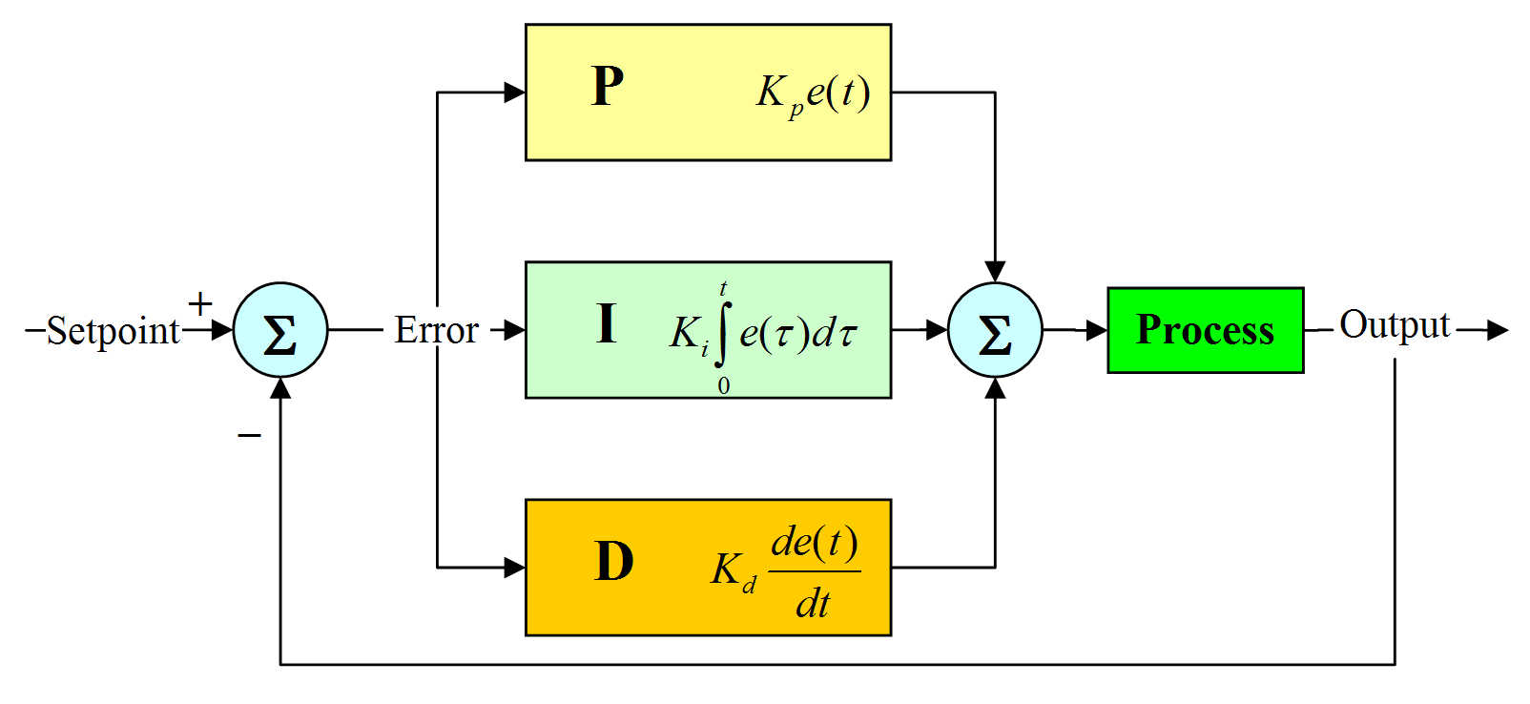
Demo Hard Computing (PID)
Proportional, Integral and Differential (PID) Controller

Slide 10
Machine Learning
Machine Learning is a subfield of computer science (CS) and artificial intelligence (AI) that deals with the construction and study of systems that can learn from data, rather than follow only explicitly programmed instructions.
Can grow, if we give new data.
Implementing in Robotics field.

Slide 11
AI and Soft Computing
cat
Animal?
cat
cut
Neural character
recognition
knowledge

Slide 12
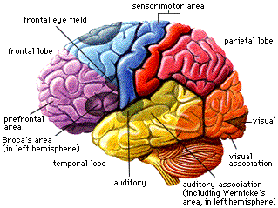
Neural Networks

Slide 13
From Conventional AI to Computational Intelligence
Intelligent Systems
Machine
Learning
Sensing Devices
(Vision)
Perceptions
Task
Generator
Inferencing
(Reasoning)
Natural
Language
Processor
Knowledge
Handler
Planning
Actions
Mechanical
Devices
Knowledge
Base
Data
Handler

Slide 14
AI and Soft computing
AI: predicate logic and symbol manipulation techniques
User
Global
Database
Inference
Engine
Question
User Interface
Explanation
Facility
KB:
Fact
rules
Response
Knowledge
Acquisition
Knowledge
Engineer
Human
Expert
Expert Systems

Slide 15
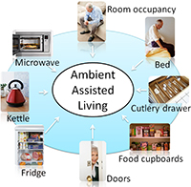
Implementation
Ambient Intelligent (AmI) - prediction techniques where behaviors of users are predicted.
Predictive ambient intelligence environments collect data acquired from a sensor network.
This predictive feature, can improve the performance of energy saving approaches in a smart environment; in addition, it enhances the convenience of occupants as well as security and safety.

Slide 16
Computational Intelligence
Computational intelligence (CI) is a set of nature-inspired computational methodologies and approaches to address complex real-world problems.
Five main paradigms of Computational Intelligence (CI), namely artificial neural networks (NN), evolutionary computation (EC), swarm intelligence (SI), artificial immune systems (AIS), and fuzzy systems (FS).
CI also embraces biologically inspired algorithms such as swarm intelligence and artificial immune systems, which can be seen as a part of evolutionary computation

Slide 17
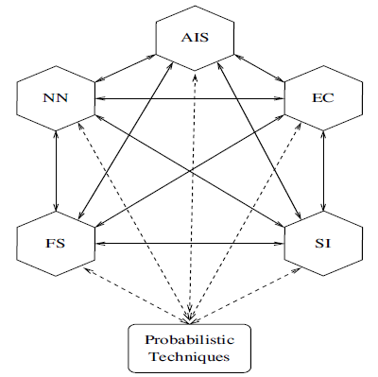
CI Paradigms
Source: Computational Intelligence,

Slide 18
Artificial Neural Networks
The brain is a complex, nonlinear and parallel computer.
It has the ability to perform tasks such as pattern recognition, perception and motor control much faster than any computer
An artificial neuron (AN) is a model of a biological neuron (BN). Each AN receives signals from the environment, gathers these signals, and when fired, transmits a signal to all connected ANs.

Slide 19
Artificial Neural Networks
Perceptron
Simple ANN to classify 2 class.
1 if x₁*w₁ + x₂*w₂ + x₃*w₃ + bias * w_{b} > 0
0 if x₁*w₁ + x₂*w₂ + x₃*w₃ + bias * w_{b} <= 0
x₁
w₁
x₂
w₂
w₃
x₃
w_{b}
Processing Unit
Linear Threshold Unit
bias
input
19

Slide 20
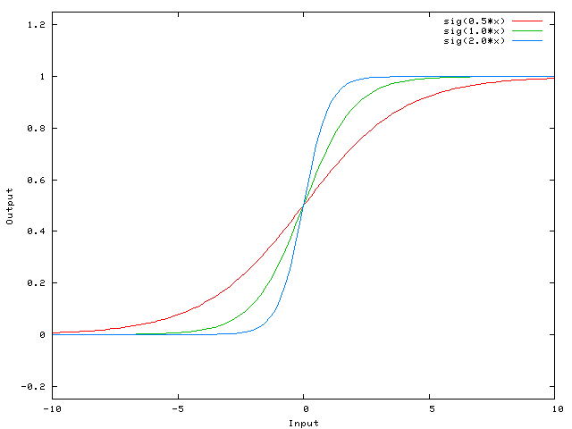

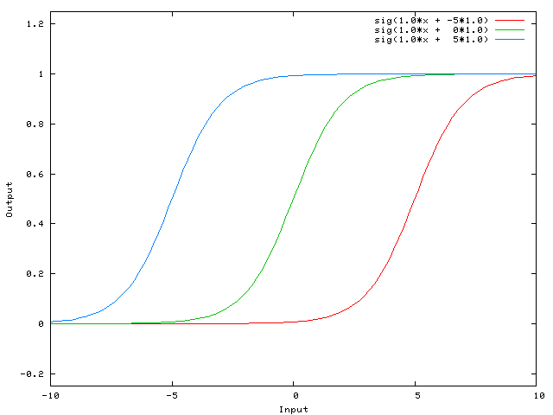
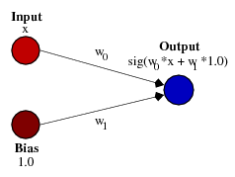
Bias Value
Having a weight of -5 for w₁ shifts the curve to the right, which allows us to have a network that outputs 0 when x is 2.

Slide 21
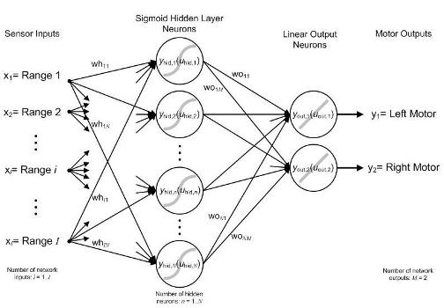
Artificial Neural Networks
An artificial neural network (ANN) is a layered network of ANs.

Slide 22
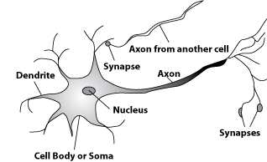
Neuron
Main component of biological neuron
Soma
Axon (output)
Dendrites (input)

Slide 23
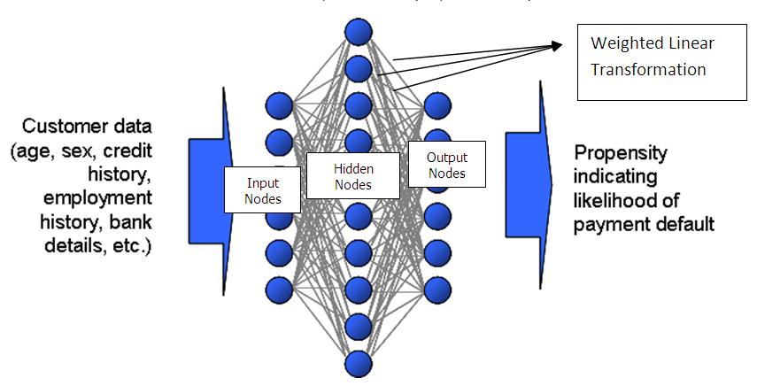
Implementation
Business applications
predict movement of stocks
marketing
Other applications
signature analysis (implemented in chip)
Speech and vision recognition systems
Process control
To output an ordered score which would discriminate the potential good accounts

Slide 24
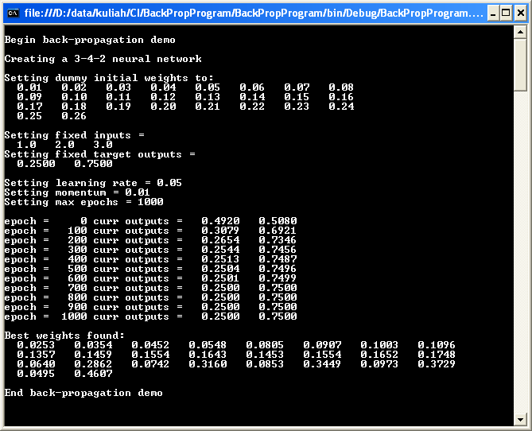
Demo Neural Network

Slide 25
Evolutionary Computation
evolutionary computation is a subfield of artificial intelligence (computational intelligence) that involves continuous optimization and combinatorial optimization problems.
Evolutionary algorithms form a subset of evolutionary computation in that they generally only involve techniques implementing mechanisms inspired by biological evolution such as reproduction, mutation, recombination, natural selection and survival of the fittest.

Slide 26
Evolutionary Computation
Evolutionary computation (EC) has as its objective to mimic processes from natural evolution, where the main concept is survival of the fittest: the weak must die.
In natural evolution, survival is achieved through reproduction. Evolutionary algorithms use a population of individuals, where an individual is referred to as a chromosome.
A chromosome defines the characteristics of individuals in the population.

Slide 27
Evolutionary Computation
Different classes of evolutionary algorithms (EA) have been developed:
Genetic algorithms which model genetic evolution.
Genetic programming which is based on genetic algorithms, but individuals are programs (represented as trees).
Evolutionary programming which is derived from the simulation of adaptive behavior in evolution (phenotypic evolution).
Evolution strategies which are geared toward modeling the strategy parameters that control variation in evolution, i.e. the evolution of evolution.
Differential evolution, which is similar to genetic algorithms, differing in the reproduction mechanism used.

Slide 28
Swarm Intelligence
Swarm intelligence (SI) originated from the study of colonies, or swarms of social organisms. Studies of the social behavior of organisms (individuals) in swarms prompted the design of very efficient optimization and clustering algorithms.
Particle swarm optimization (PSO) is a stochastic optimization approach, modeled on the social behavior of bird flocks.
Studies of ant colonies have contributed in abundance to the set of intelligent algorithms.
The modeling of pheromone depositing by ants in their search for the shortest paths to food sources resulted in the development of shortest path optimization algorithms.

Slide 29
Fuzzy Systems
Fuzzy sets and fuzzy logic allow what is referred to as approximate reasoning. With fuzzy sets, an element belongs to a set to a certain degree of certainty.
Fuzzy logic allows reasoning with these uncertain facts to infer new facts, with a degree of certainty associated with each fact. In a sense, fuzzy sets and logic allow the modeling of common sense.
Fuzzy systems have been applied successfully to control systems, gear transmission and braking systems in vehicles, controlling lifts, home appliances, controlling traffic signals etc.

Slide 30
Fuzzy Sets Theory
What is fuzzy thinking
Experts rely on common sense when they solve the problems
Fuzzy logic is not logic that is fuzzy but logic that is used to describe the fuzziness. Fuzzy logic is the theory of fuzzy sets, set that calibrate the vagueness.
Fuzzy logic is based on the idea that all things admit of degrees. Temperature, height, speed, distance, beauty – all come on a sliding scale.
Jim is tall guy
It is really very hot today

Slide 31
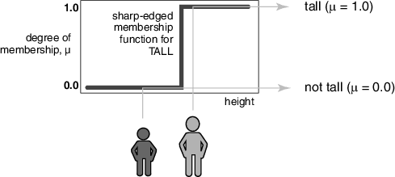
Fuzzy Sets Theory

Slide 32
Fuzzy Sets Theory
Communication of “fuzzy “ idea
This box is too heavy..
Therefore, we need a lighter one…

Slide 33
Fuzzy Sets Theory
Boolean logic
Uses sharp distinctions. It forces us to draw a line between a members of class and non members.
Fuzzy logic
Reflects how people think. It attempt to model our senses of words, our decision making and our common sense -> more human and intelligent systems

Slide 34

Fuzzy Sets Theory
Prof. Lotfi Zadeh

Slide 35
Fuzzy Sets Theory
Classical Set vs Fuzzy set
No | Name | Height (cm) | Degree of Membership of “tall men”
 |  |  | Crisp | Fuzzy
1 | Boy | 206 | 1 | 1
2 | Martin | 190 | 1 | 1
3 | Dewanto | 175 | 0 | 0.8
4 | Joko | 160 | 0 | 0.7
5 | Kom | 155 | 0 | 0.4

Slide 36
Fuzzy Sets Theory
Classical Set vs Fuzzy set
Membership value
Membership value
1
1
0
0
175
Height(cm)
175
Height(cm)
Universe of discourse

Slide 37
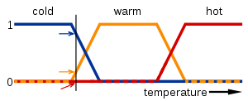
Example
the meanings of the expressions cold, warm, and hot are represented by functions mapping a temperature scale.

Slide 38
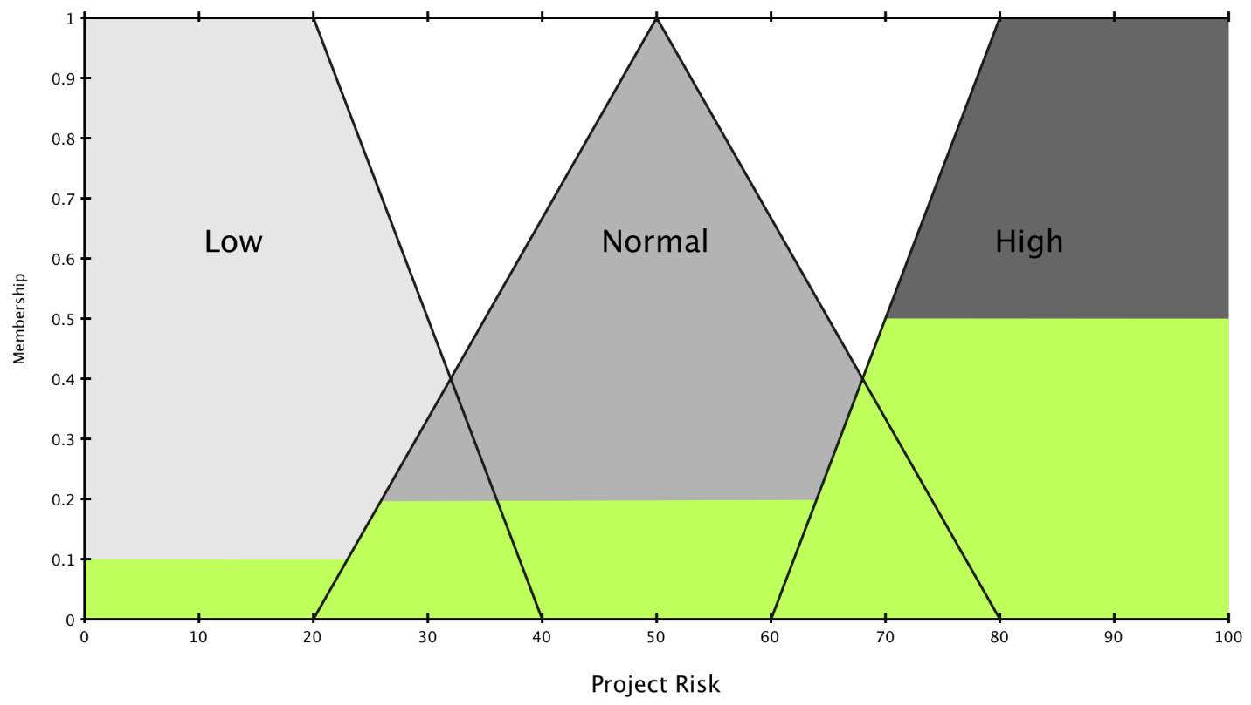
Example
The problem is to estimate the level of risk involved in a software engineering project. For the sake of simplicity we will arrive at our conclusion based on two inputs: project funding and project staffing.
Source: http://petro.tanrei.ca/fuzzylogic/fuzzy_negnevistky.html

Slide 39
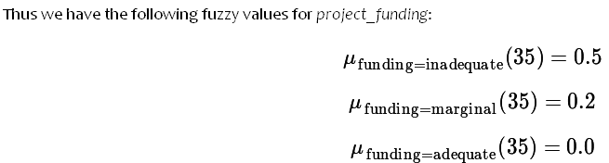
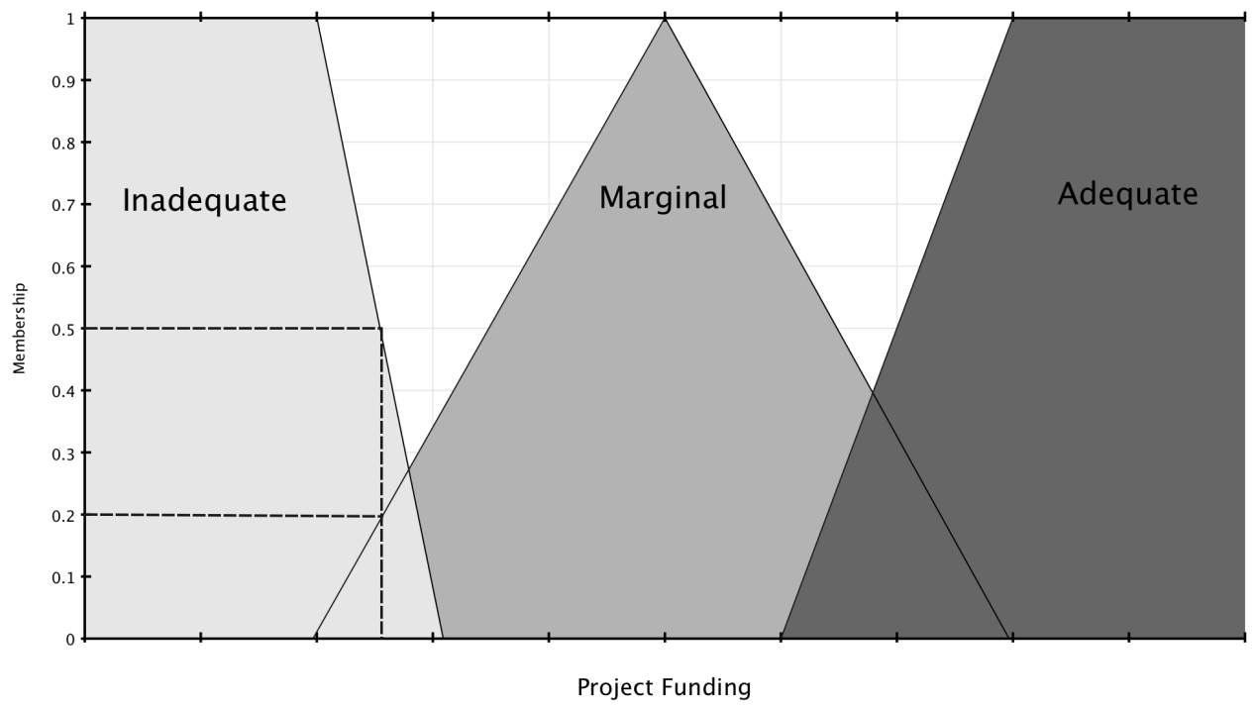
Project Funding
Suppose our our inputs are project_funding = 35% and project_staffing = 60%.

Slide 40
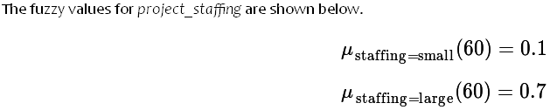
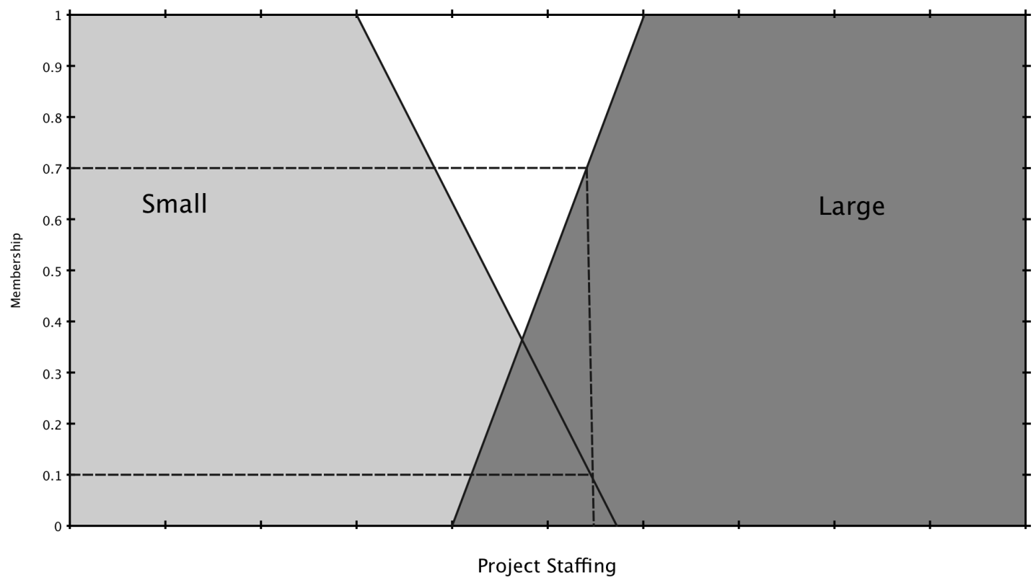
Project Staffing

Slide 41
The rules
If project_funding is adequate or project_staffing is small then risk is low.
If project_funding is marginal and project_staffing is large then risk is normal.
If project_funding is inadequate then risk is high.

Slide 42
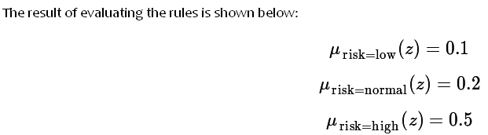
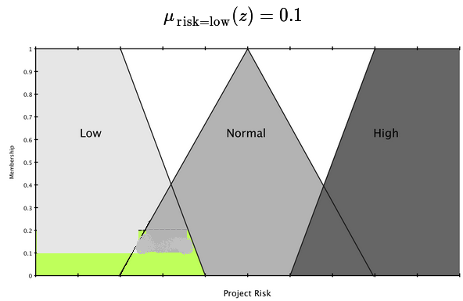
Rule Evaluation results

Slide 43
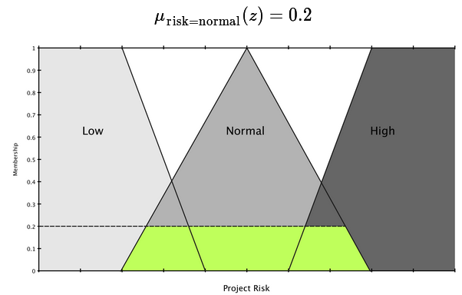
Rule Evaluation results

Slide 44
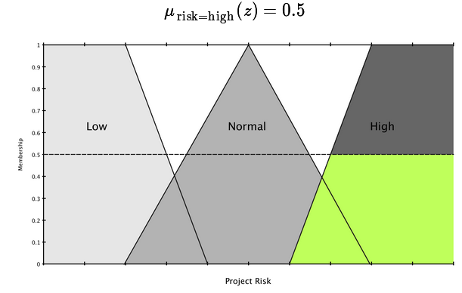
Rule Evaluation results

Slide 45

Calculation
We perform a union on all of the scaled functions to obtain the final result

Slide 46


Result
The defuzzification can be performed in several different ways. The most popular method is the centroid method.

Slide 47
Result
We chose the centroid method to find the final non-fuzzy risk value associated with our project. This is shown below.
The result is that this project has 67.4% risk associated with it given the definitions above.

Slide 48
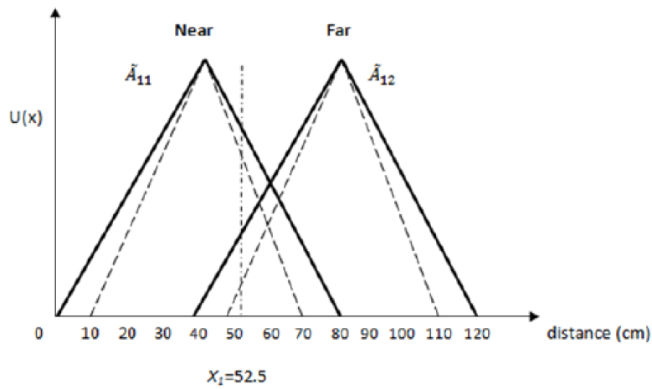
Fuzzy Logic Type 2
To handle uncertainty better than Fuzzy Logic

Slide 49
exercise
Please mention future implementation of CI in industries
Please find out some implementations of Swarm Intelligence in industries.

Slide 50
References
Andries P. Engelbrect. (2007), Computational Intelligence An Introduction. 2nd Ed. John Wiley & Sons. USA. ISBN: 978-0-470-03561-0
James M. Keller, Derong Liu, David B. Fogel (2016). Fundamentals of Computational Intelligence. Neural Networks, Fuzzy Systems and Evolutionary Computation, Wiley ISBN 978-1-110-21434-2
Bansal, Jagdish Chand, Pramod Kumar Singh, and Nikhil R. Pal . (2017) "Evolutionary and Swarm Intelligence Algorithms", Springer, ISBN 978-3-319-91339-1
James D. McCafrey (2014). Neural Network using c# Succinctly, Syncfusion Publisher.
Bernhard, Korte, and J. Vygen (2008), "Combinatorial optimization: Theory and algorithms." Springer, Third Edition.
Roger Jang (1997). Fuzzy and Soft Computing: A Computational Approach to Learning and Machine Intelligence. 1st ed. Prentice Hall Publisher. ISBN: 978-0132610667

Slide 51
Thank You

